Slide 1
Unit - ii
2.2 Supply
Edited by
Parul
Notes:
1

Slide 2
Supply
The quantity offered for sale at a particular price and during a particular time by the producer.
THREE elements of supply –
Quantity supplied
Price
Period of time
S NEHRA EFE UNIT II 2.2
1
Notes:
1

Slide 3
Factors affecting / Influencing/ Determinants of Supply
Price of the commodity -
Price of other commodity – Football Vs volleyball, Price of computer hardware and supply of software
Goal of the firm – Profit / Sales maximization
Prices of factors of production
State of technology – Picture tube /panel price and CTV/LCD price
Future expectations regarding the price
Natural factors – Rainfall, Soil, Climatic conditions
Government policies - Taxes and Subsidies
Euro norms for vehicles, Removal of quantitative restrictions on the trade
S NEHRA EFE UNIT II 2.2
1
Notes:
1

Slide 4
Review question
Factors affecting the supply of Indian software export services?
My Answer
Government policies
Labour cost
Price factors of production
Competitors
Substitute ,if higher salary demanded shift to other countries
Technology (price of production)
India can have cheap labour
S NEHRA EFE UNIT II 2.2
1

Slide 5
Review question
Farmers can plant either corn or soybeans in their fields. Which of the following would cause the supply of soybeans to rise?
an increase in the price of soybeans
a decrease in the price of corn
an increase in the demand for corn
an increase in the price of soybean seeds
S NEHRA EFE UNIT II 2.2
My Answer
a) an increase in the price of soybeans.
Soyabean price increase thus farmer shifts from growing corn to growing soyabeans.
Corns and soyabeans are not substitute goods. So ans not b) if substitue goods then,
Decrease in the price of corn -> quantity demand soyabean increases
1

Slide 6
Supply function
It expresses the functional relationship between the supply of a commodity and its various determinants
S NEHRA EFE UNIT II 2.2
1
Notes:
1

Slide 7
Law of Supply
Other things being equal, the quantity supplied of a commodity varies directly with its price.
In other words, when price of a commodity rises, supply increases and vice-versa.
S NEHRA EFE UNIT II 2.2
1
Notes:
1

Slide 8
Supply schedule – A tabular representation
Individual supply schedule – Shows individual quantities of a commodity that a producer is prepared to sell at various prices
Market supply schedule – Gives the same information about the whole market of a given commodity
S NEHRA EFE UNIT II 2.2
1
Notes:
1

Slide 9
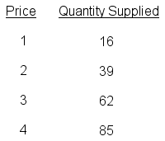
Supply schedule
S NEHRA EFE UNIT II 2.2
1
Notes:
1

Slide 10
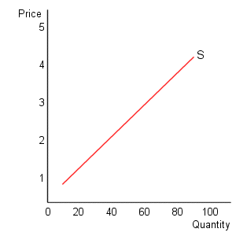
Supply Curve
S NEHRA EFE UNIT II 2.2
1
Notes:
1

Slide 11
Assumptions of the law
No change in the price of related goods
No change in the state of technology
No change in the goals of the firm
No change in the price of factors of production
No change in the expected price of the commodity by the producer
S NEHRA EFE UNIT II 2.2
1
Notes:
1

Slide 12
Why does supply curve slope upwards?
Law of diminishing marginal productivity – Marginal unit increases cost. So more will be supplied at higher price
Change in stock – If price rises, sellers are ready to sell more from their old stocks
Profit and loss – If Price rises, supply will increase and profit will go up
Entry and exit of new firms – If profit, new firms will enter and supply will increase
S NEHRA EFE UNIT II 2.2
1
Notes:
1

Slide 13
Exceptions of the law
Future expectations about change in the price
In case of agricultural goods: even though the price rises the area for cultivation remains same or may not increase more because of resource constraint.
In case of perishable goods: No storage facility.
Goods of auction: selling say Tajmahal, supply of Tajmahal can not increase.
In case of rare goods – Ex- Poems, Paintings
In case of backward countries
S NEHRA EFE UNIT II 2.2
1
Notes:
1

Slide 14
Changes in supply
Movements along the same supply curve
Shifts in supply curve
S NEHRA EFE UNIT II 2.2
1
Notes:
1

Slide 15
Movements along the same supply curve
When the supply of a commodity changes due to change in its price, it is reflected by different points on a supply curve which is called as movement along the same supply curve
Types -
Other things being equal, when supply of a commodity expands due to rise in its price, it is called extension of supply
Other things being equal, when the supply of a commodity falls a result of fall in its price, it is called contraction of supply
S NEHRA EFE UNIT II 2.2
1
Notes:
1

Slide 16
Shifts in supply curve
When the supply of a commodity changes due to the factors other than the price, it is called change / shift in supply.
Types –
When more quantity is supplies at the same price, the situation is called as increase in supply
When less quantity is supplied at the same price , the situation is called as decrease in supply
S NEHRA EFE UNIT II 2.2
1
Notes:
1

Slide 17
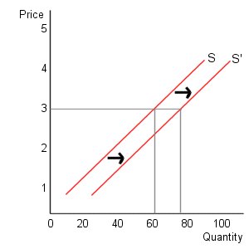
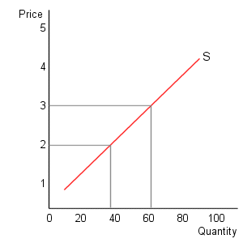
Change in supply vs. change in quantity supplied
Change in supply Change in quantity supplied
S NEHRA EFE UNIT II 2.2
1
Notes:
<number>

Slide 18
Review question
A company produces steel almirahs of a given type, dimension and quality. The market price of steel rises by 20 per cent. Illustrate how this would affect the company’s supply curve of almirahs?
S NEHRA EFE UNIT II 2.2
My Answer
Curve shifts left, Caution :Market price of steel(raw material), and not almirah is
Affected thus supply decreses (Note : Supply decrese supply required is same.)
1

Slide 19
An increase in the price of steel reflects an input price increase. This will imply that at the same price for an almirah, the company will supply less.
S NEHRA EFE UNIT II 2.2
1

Slide 20
Which of the following would shift the supply curve for energy drinks to the left?
a decrease in the expected future price of energy drinks
an increase in consumer income (assuming that energy drinks are normal goods)
a decrease in the number of firms that produce energy drinks
a decrease in the price of an input used to produce energy drinks
S NEHRA EFE UNIT II 2.2
1

Slide 21
answer
a decrease in the number of firms that produce energy drinks
S NEHRA EFE UNIT II 2.2
1

Slide 22
Review question - identify movement or shift in supply curve
During a real estate boom that causes houses prices to rise, more homeowners put their houses up for sale.
Many watermelon farmers open temporary roadside stands during harvest season.
The Indian government establishes a new regulation that all seat belts in front as well as in the backseat must contain airbags.
The government offers tax incentives to mobile manufacturing firms under the Make in India programme.
S NEHRA EFE UNIT II 2.2
1

Slide 23
My Answer
1 Movement
2 Shift
3 Shift
4 Shift

